Slide 1

Netflix Case Study
Sai Vineeth

Slide 2
Group different movies using text and clustering algorithm.
Use the clusters as labels to build a classification model (either Deep learning or Sequence models)

Slide 3
Build Models by:
Using cast, director, country, rating and genres as features.
Using the words in the movie/TV show descriptions as features.

Slide 4
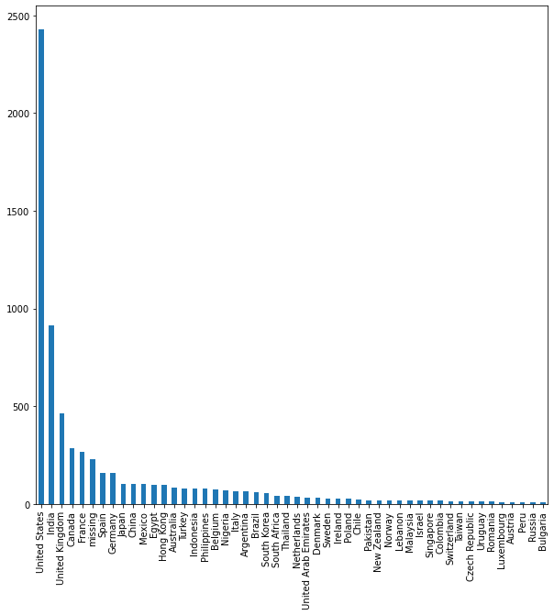
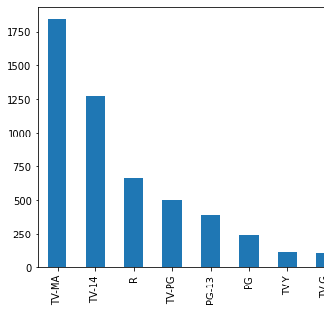
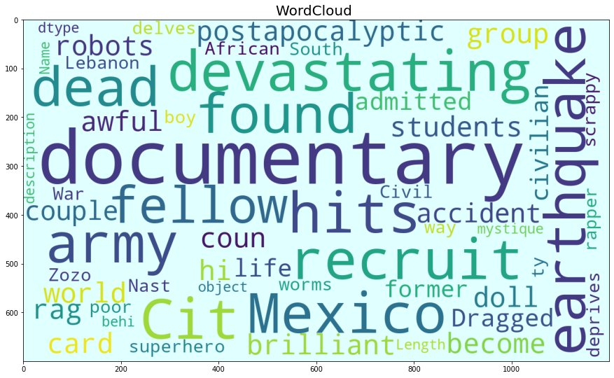
Exploratory Analysis

Slide 5
Approach
Data preprocessing
Text
Word Embeddings
Topic Modelling
Feature Engineering
Unrelated date & conversion
Feature Engineering
Genre & ratings to one hot
Feature Engineering
Categorical Feature EDA
EDA
LDA
Hyperparameter Tuning
Topics
Agglomerative Clustering & H Tuning

Slide 6
Data Preprocessing
Text
Remaining feature cleaning
EDA
Unrelated Date and Genre
Genre & Ratings to One Hot
Text Preprocessing
Tokenization
Normalizing text data(Stop words)
Tokenization
Normalizing text data(Stop words)
Make bigrams, Trigrams and Lemmatize
Pos tagging & filtering & lemmatize

Slide 7
Topic modelling
LDA
Base Model- parameter
Hyperparameter Tuning
Final Model
Choose Topics
Using gensis corpus crcreate dictionary and embeddings
Topics
Hyperparameter Tuning
Agglomerative Base
Clusters

Slide 8
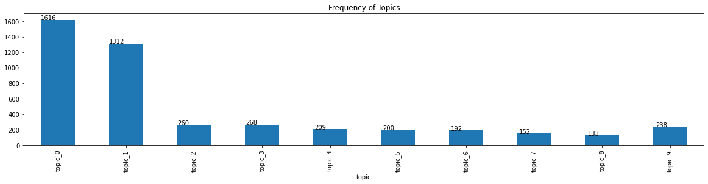
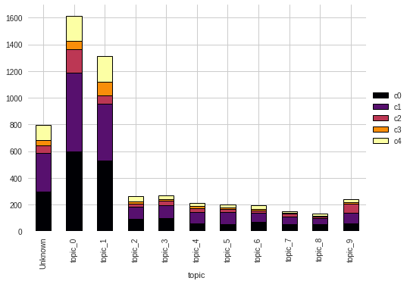

Slide 9
Data with clusters
Data Tranformation
Text augmentation
Data imbalance across labels
EDA label distribution
Word Embedding
Text CNN pytorch
Model evaluation
Hyperparameter Tuning
Metrics
Test Data Evaluation
Split dataset into Train Validation and Test

Slide 10
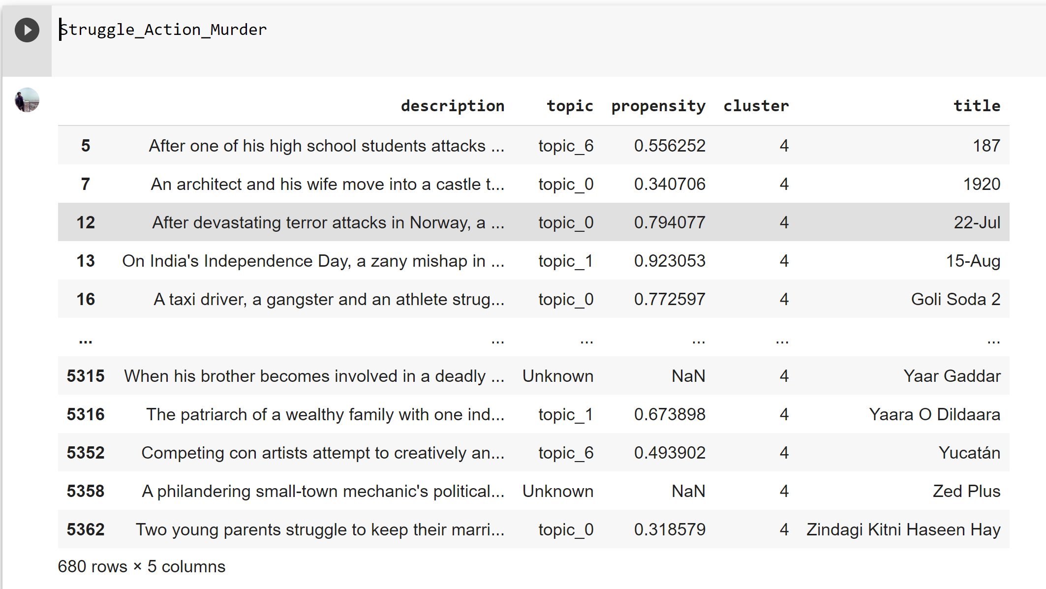
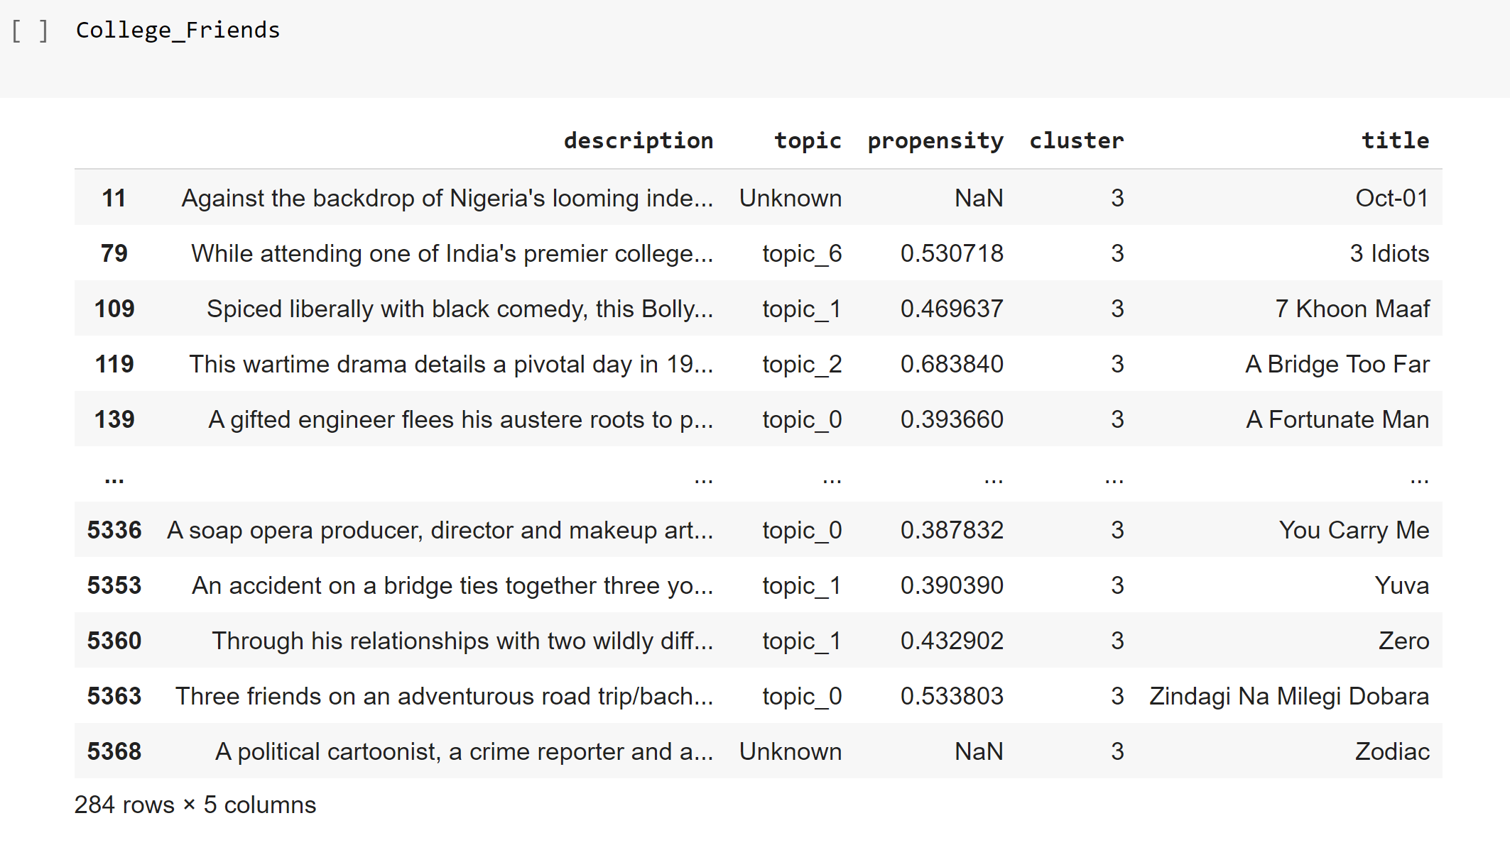
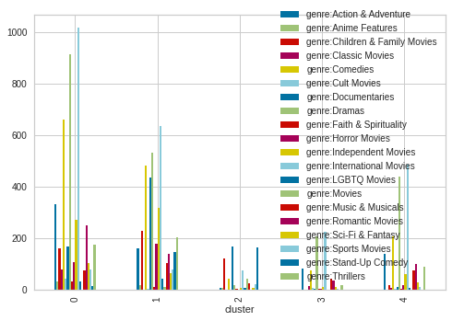

Slide 11
